Slide 1
Information Technology and Components of an IT System

Slide 2
Information Technology
What is IT Important?
Information Technology (IT) refers to the use of computers, networks, storage devices, and software to manage and process data. It helps individuals and organizations collect, store, retrieve, transmit, and manipulate information efficiently.
Why is IT Important?
IT enables faster decision-making, efficient communication, automation, and cost savings in all industries.
Without IT, modern businesses cannot operate competitively.
Examples in Daily Life:
Google Maps for navigation
UPI apps like Paytm or PhonePe
Online shopping and tracking (Amazon, Flipkart)

Slide 3
Need of Information Technology
Shift from Industrial Based Economy to Knowledge Based Economy.
Over the last two decades, rising competition has transformed businesses. Earlier, companies focused on manufacturing products first and then finding customers, with long cost recovery periods. Now, with real-time competition and shorter product life cycles, businesses must continuously innovate. To stay competitive, they must integrate information technology into their processes.
Shift in Organisational Structures.
Organisations are shifting from hierarchical to flat, networked structures. Decision-making is moving from centralised to decentralised systems. Virtual teams now allow employees to work remotely without being physically present at project sites. This is made possible by integrating information flow through a common IT-enabled network.
Emergence of Digital Economy.
We now live in a knowledge economy, driven by the knowledge held by organisations and their employees. This shift has changed lifestyles and increased the use of technology. The rise of the digital economy allows instant access to and sharing of information, enabling communication beyond time and location limits—driving greater productivity and innovation.

Slide 4
Role of IT in Management
1. IT Helps in Decision-Making
Managers rely on Management Information Systems (MIS) to get data reports like sales trends, customer feedback, etc.
Example: A manager at a retail store uses IT to know which product sells the most during weekends.
2. Automation of Business Processes
HR software for payroll
Inventory tracking in real-time
Chatbots for customer service
3. IT Gives Strategic Advantage
Competitive edge through data analytics and personalized services.
Example: Amazon recommends products based on your search history — powered by IT.
4. IT Tools in Use:
ERP (Enterprise Resource Planning): Combines all business functions in one software
CRM (Customer Relationship Management): Helps manage customer data and communication

Slide 5
Tools That Drive Business Decisions
1. MIS – Management Information System
“Provides summarized, structured reports to help managers monitor and make decisions.”
Collects, processes, and presents internal data (sales, HR, finance)
Helps in routine decision-making
Example: Daily sales report emailed to a store manager
Zomato's use of IT in Management:
Uses CRM to track customer preferences, order history, and behavior
Uses ERP to coordinate between restaurants, delivery, and payment systems
Uses MIS to analyze delivery times, order volumes, and vendor performance for management reports
2. ERP – Enterprise Resource Planning
“An integrated software system that combines all business functions (HR, Inventory, Finance) into one platform.”
Allows departments to share real-time data
Improves coordination, reduces duplication
Example: When a sale is made, inventory is updated, billing is generated, and accounts are notified automatically
3. CRM – Customer Relationship Management
“A system that manages a company’s interactions with current and potential customers.”
Tracks leads, sales calls, customer feedback
Helps marketing & sales teams understand behavior
Example: Zomato recommends restaurants based on your past orders using CRM

Slide 6
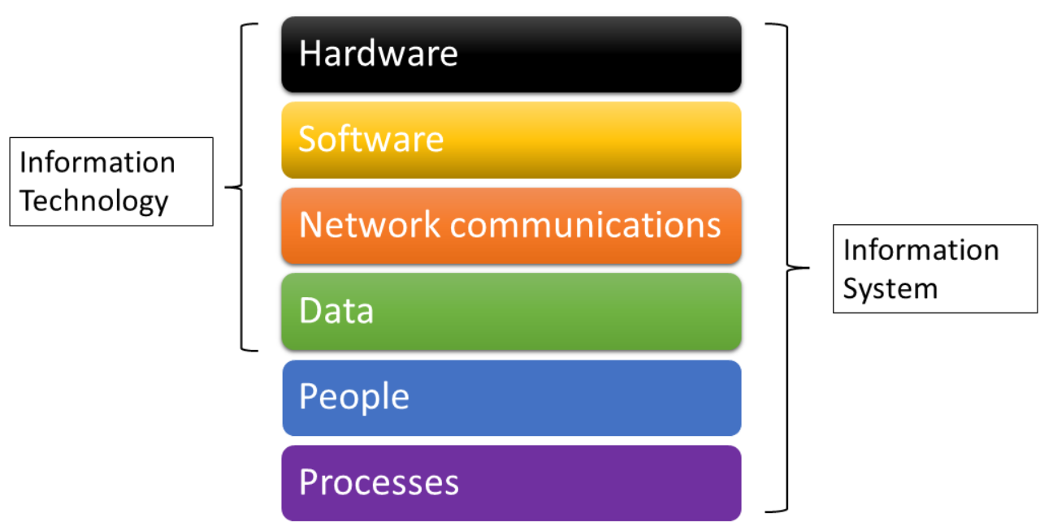
Components of IT System – Overview

Slide 7
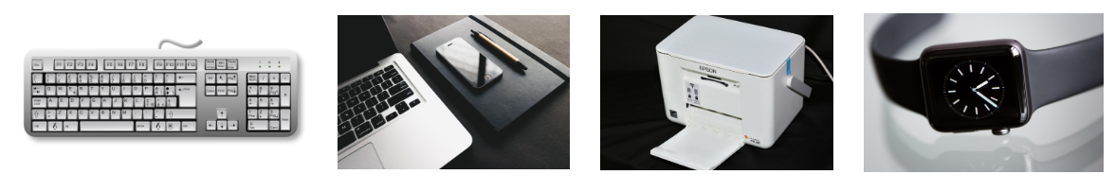
Hardware in IT System
Definition: Hardware represents the physical components of an information system. Some can be seen or touched easily, while others reside inside a device that can only be seen by opening up the device's case. Keyboards, mice, pens, disk drives, iPads, printers, and flash drives are all visible examples. Computer chips, motherboards, and internal memory chips are the hardware that resides inside a computer case and is not usually visible from the outside. For example, users use a keyboard to enter data or a pen to draw pictures.
Examples:
Input Devices: Keyboard, Mouse, Scanner
Output Devices: Monitor, Printer, Projector
Processing Devices: CPU, GPU
Storage Devices: Hard Drive, SSD, Pen Drive

Slide 8
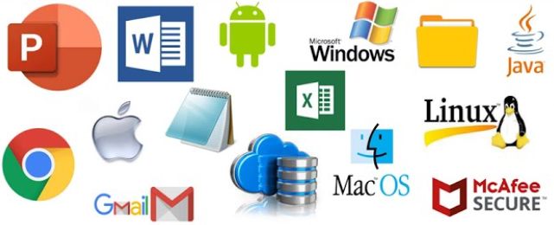
Software in IT System
Software is a set of instructions that tell the hardware what to do. Software is not tangible – it cannot be touched. Programmers create software programs by following a specific process to enter a list of instructions that tell the hardware what to do. There are several software categories, the two main types being operating systemsand application software.Types:
System Software: OS like Windows, Linux, MacOS (controls hardware)
Application Software: Word processors, Browsers, Zoom, Excel (used for tasks)
Utility Software: Antivirus, Disk Cleanup

Slide 9
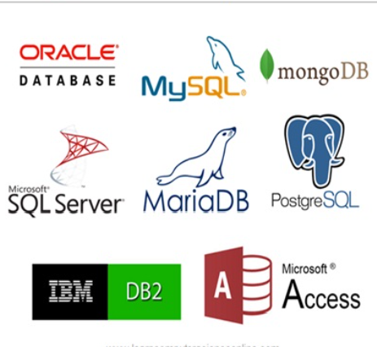
Data in IT System
Data
Raw facts and figures collected from various sources
Can be structured (tables), unstructured (videos, emails), or semi-structured (XML, JSON)
Used for analysis, decision-making, and operations
Examples: Customer names, sensor data, sales records
Database
A structured system to store, manage, and retrieve data
Ensures data integrity, security, and easy access
Supports multiple users and applications
Types:
Relational (SQL): MySQL, Oracle
Non-relational (NoSQL): MongoDB, Firebase

Slide 10
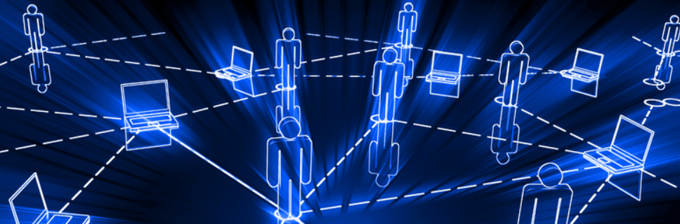
Network in IT System
A network is a system of interconnected computers, servers, and devices that communicate and share resources.
Purpose: To enable data exchange, resource sharing, and communication between different components of the IT system.
Types:
LAN (Local Area Network): Office, school, home network
WAN (Wide Area Network): Internet

Slide 11
People
People built computers for people to use. It means that there are many different categories in the development and management of information systems to help organizations to create value and improve productivity, such as:
Users are those who use an IS to perform a job function or task. Examples include a student using a spreadsheet or a word-processing software program.
Technical Developers are the people who create the technologies used to build an information system. Examples include a computer chip engineer, a software programmer, and an application programmer.
IT Support: These specialized professionals are trained to keep the information systems running smoothly to support the business and keep it safe from illegal attacks. Examples include network analysts, data center support, and help desk support.
Business Professionals: these are the CEOs, owners, managers, entrepreneurs, and employees who use IS to start or expand their businesses to perform their job functions such as accounting, marketing, sales, human resources, and supporting customers, among others.

Slide 12
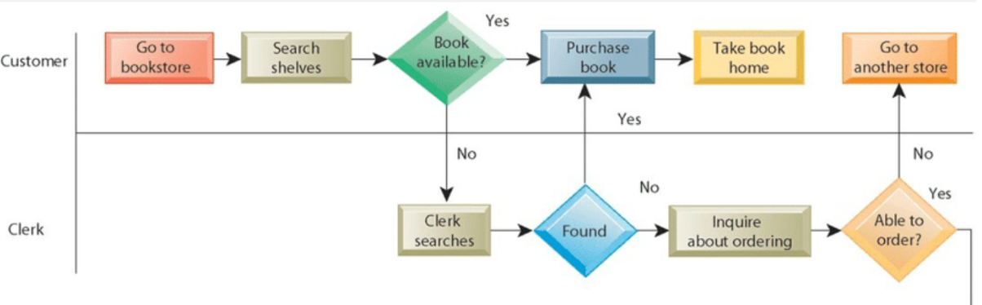
Process
Processes are a set of structured activities or steps that guide how tasks are performed in an IT system to achieve specific goals.
Purpose: To ensure that IT resources (hardware, software, data, people, networks) are used efficiently and consistently to deliver business value.

